Slide 1
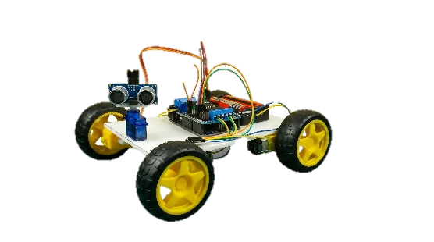

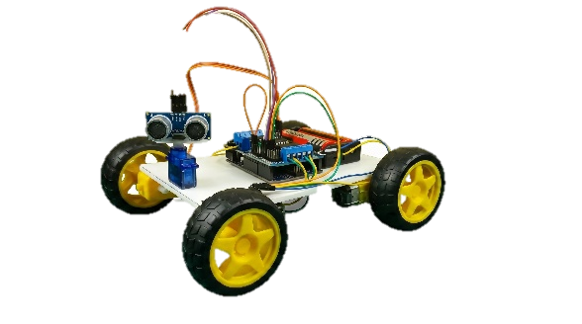
MULTI-FUNCTION ROBOT CAR USING ARDUINO UNO
A Final Year Project Report
Student Name | Roll No
Dus Mamud | CHP/23/EL/020
Iswar Ch. Das | CHP/23/EL/025
Bhardwaj Sarkar | CHP/23/EL/008
Anup Das | CHP/23/EL/005
Dibyajyoti Das | CHP/23/EL/016
Nazrul Islam | CHP/23/EL/046
Sourab Sarkar | CHP/23/EL/059
Under the Guidance of: Ms. Chinmayee Medhi, Lecturer, Electrical Engg
Dept. of Electrical Engineering | Chirang Polytechnic, Bijni, Assam | 26th May, 2026

Slide 2
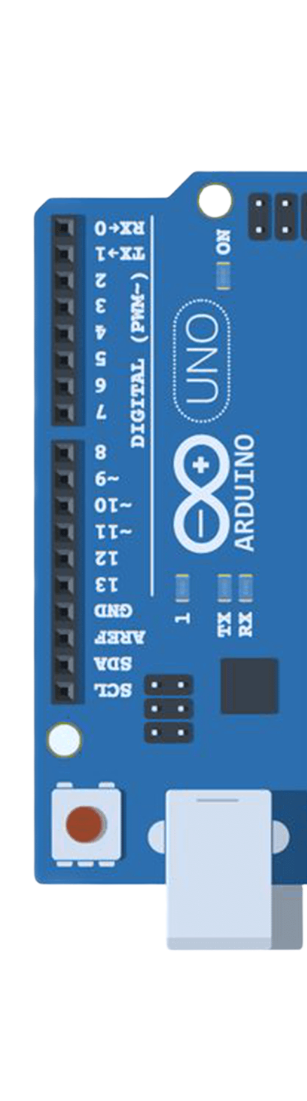
Contents
01 - Objectives
02 – Introduction
03 – System Block Diagram
04 – Circuit Connection
05 – Working Principle
06 – Flowchart
07 – Software Platforms
08 - Hardware Components
09 – Introduction
10 – Advantages & Disadvantages
11 – Test Results
12 – Conclusion
13 – Future Enhancement
14 – References
─────────── ◆ ───────────
01

Slide 3
Objectives of the Project
Design, build and program a multi-function robot car with 3 control modes in 1 platform
Build stable 4-wheel foam board chassis. Mount all electronics securely.
Obj. 1 – Chassis Construction
HC-SR04 detects 12 cm or less-Stop, Backward, Scan, Turn to clear path.
Obj. 2 – Obstacle Avoidance
Commands: F=Forward, B=Backward, L=Left, R=Right, S=Stop via smartphone app.
Obj. 3 – Bluetooth Manual Control
Voice commands via app. Safety check before Left or Right turn blocks if less than 10 cm.
Obj. 4 – Voice Control with Safety
3 separate functions: Obstacle, Bluetooth control, voice control 1-line mode switching.
Obj. 5 – Modular Code Design
02

Slide 4
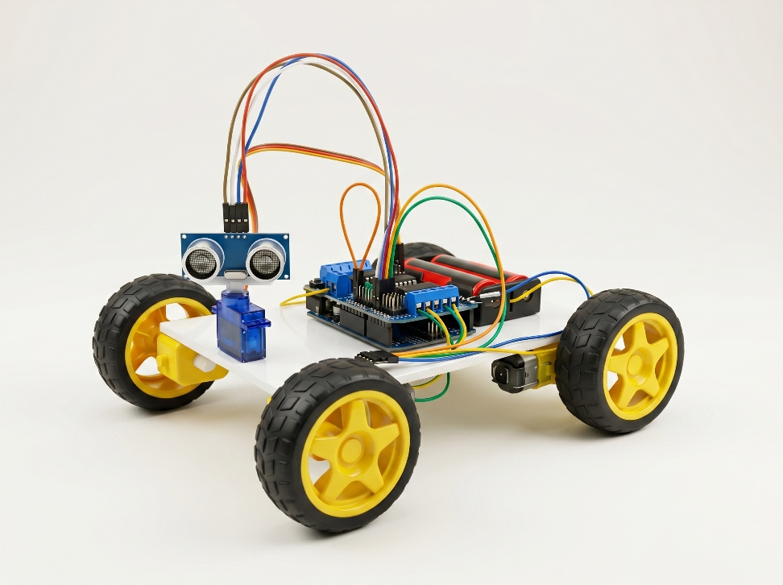
Introduction
In today's era of automation, this project presents a three-mode intelligent robot car built on Arduino UNO combining autonomous sensing, wireless control, and voice interaction in one affordable platform.
Mode 2 - Bluetooth Control
Mode 2 - Bluetooth Control
Mode 2 - Bluetooth Control
Autonomous navigation using HC-SR04 ultrasonic sensor.
Autonomous navigation using HC-SR04 ultrasonic sensor.
Autonomous navigation using HC-SR04 ultrasonic sensor.
Problem Addressed:
× Low-cost robots support only 1 mode
× Bluetooth cars execute commands blindly - no safety
× Voice control rarely implemented at student level
✓ This project solves all three at approximately Rs.1,200.
03

Slide 5
System Block Diagram
POWER SUPPLY –
2x Li-ion 3.7V = 7.4 Total
ARDUINO UNO – ATmega328P, 16 MHz – Central Control Unit
HC-05
Bluetooth Module
HC – SROR
Ultrasonic Sensor
SG90 Servo Motor – Scanning
L293D Motor Driver Shield
M1
M1
M1
M1
DC Gear Motor
DC Gear Motor
DC Gear Motor
DC Gear Motor
→ Android App to HC-05 to Arduino – Commands
→ HC-SR04 to Arduino Real-time distance data
→ Arduino to L293D Shield to M1 through M4 Motors
04

Slide 6
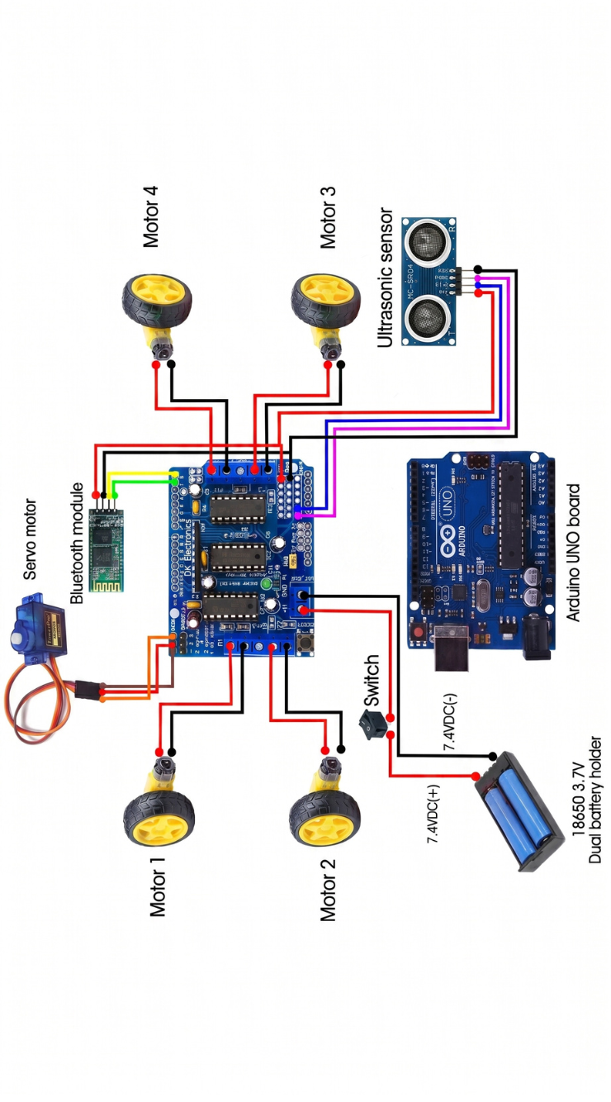
Circuit Connection & Pin Configuration
Component | Pin | Connected To
HC-SR04 Ultrasonic Sensor | TRIG | Arduino Al Digital Output
 | ECHO | Arduino A0 Digital Input
 | VCC | 5V Power
 | GND | GND Ground
SC90 Servo Motor | Signal (Orange) | Arduino Pin 10 PWM Output
 | VCC (Red) | 5V
 | GND (Brown) | GND
HC-05 Bluetooth Module | TX | Arduino Pin 0 RX Serial In
 | RX | Arduino Pin 1 TX Serial Out
 | VCC | 5V
 | GND | GND
DC Motor M1 (Front-Left) | Both Wires | Shield M1 Terminal
DC Motor M2 (Rear-Left) | Both Wires | Shield M2 Terminal
DC Motor M3 (Front-Right) | Both Wires | Shield M3 Terminal
DC Motor M4 (Rear-Right) | Both Wires | Shield M4 Terminal
Battery Pack (7.4V) | Positive (+) | Shield EXT PWR positive
 | Negative (-) | EXT PWR negative GND
05

Slide 7



Step-by-Step Working Principle
Mode 1 – Obstacle Avoidance
Mode 1 – Bluetooth Control
Step 1: Power ON - Servo centers at 103 degrees - Motors speed set to 170.
Step 2: HC-SR04 fires 10 microsecond pulse from TRIG pin A1.
Step 3: Distance equals Echo pulse divided by 29 divided by 2, result in cm.
Step 4: If distance greater than 12 cm -execute forward function.
Step 5: If distance 12 cm or less-Stop, Backward 100ms, Stop. Servo to 180 degrees, measure Left. Servo to 20 degrees, measure Right. If Left less than Right, turn right 500ms. If Left greater than Right, turn left 500ms.
Step 1: HC-05 pairs with smartphone, PIN 1234.
Step 2: App sends character via UART at 9600 baud.
Step 3: Arduino reads via Serial.read function.
Character | Action
‘F’ | Forward
‘B’ | Backward
‘L’ | Left
‘R’ | Right
‘S’ | Stop
RoboNex
Bluetooth
Voice
06

Slide 8
Working Principle – Mode 3: Voice Control
Safety – Aware Voice Command System
Voice Word | Character | Action
Forward | ^ | Move Forward
Backward | - | Move Backward
Left | < | Check and turn left
Right | > | Check and turn right
Stop | * | Stop all motors
Step 1: Voice command configured in app settings-5 total commands.
Step 2: User speaks, app recognizes speech, sends character via Bluetooth.
Step 3: Forward, Backward, Stop -immediate execution, no delay.
Step 4: Left-leftsee function checks side clearance first. If 10 cm or more, execute left turn 500ms then stop. If less than 10 cm, stop immediately - safety blocked.
Step 5: Same safety logic applies for Right using rightsee function.
Safety Feature: If clearance is less than
10 cm on the turning side, the robot stops automatically. Collision prevention always active in Voice Mode.
07

Slide 9
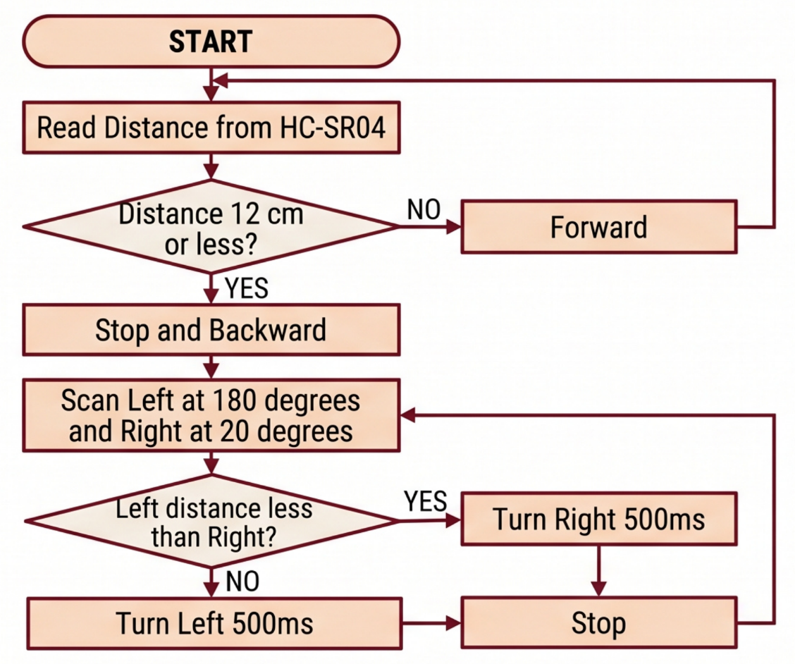
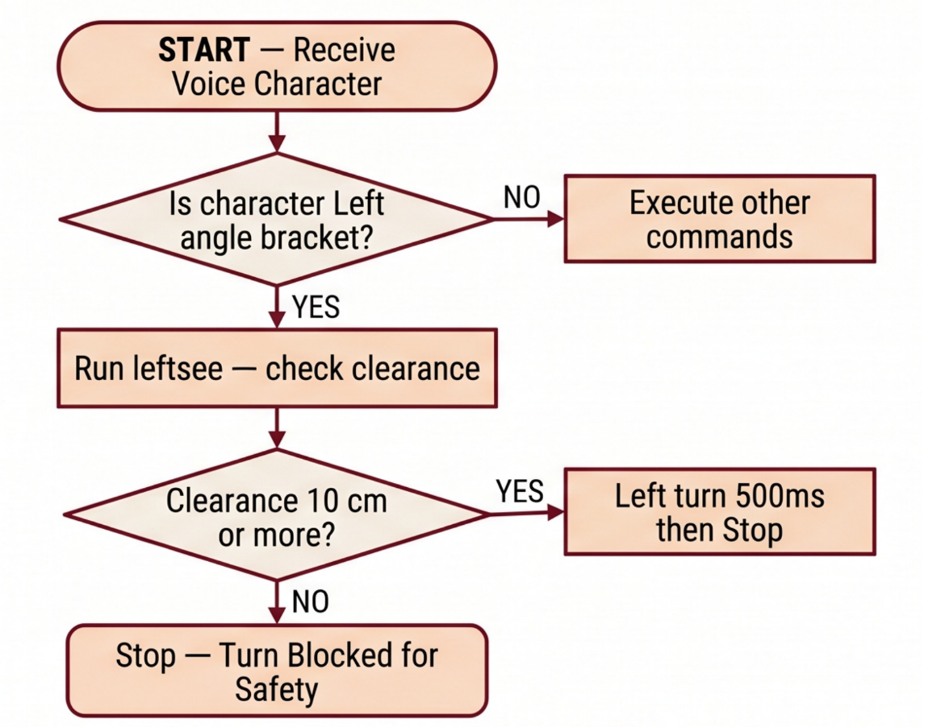
System Flowchart
Flowchart 1 – Obstacle Avoidance Mode
Flowchart 2 – Voice Control
08

Slide 10


Software Platforms Used
Arduino IDE
Bluetooth Controller App
Language: C and C++ Arduino flavored
Purpose: Write, compile and upload code
Feature: Serial Monitor for real-time debugging
Download: arduino.cc/en/software
Platform: Android smartphone
Purpose: Send directional and voice cmd’s
Pairs with: HC-05, PIN 1234
Baud Rate: 9600 bps, D-pad and voice configuration
Libraries Used
1. Servo.h -Controls SG90 servo motor signal, servo.write angle sets position
2. AFMotor.h - Controls L293D shield, FORWARD BACKWARD RELEASE and setSpeed 0 to 255
Mode Switching - one line at a tim
void loop
// comment Obstacle Mode 1
// comment Bluetoothcontrol Mode 2
// comment voicecontrol Mode 3
09

Slide 11
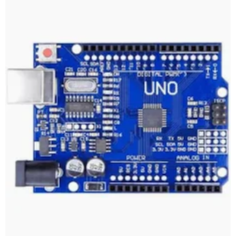
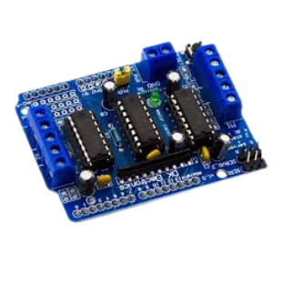
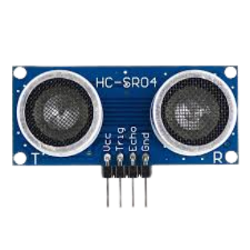
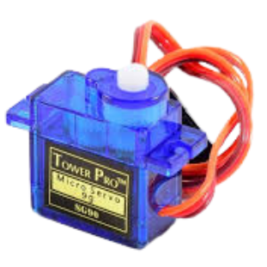
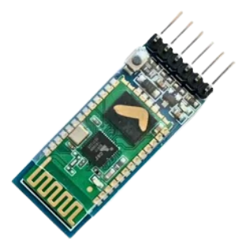
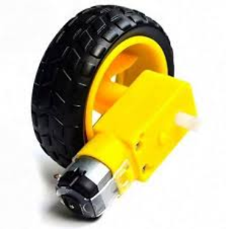
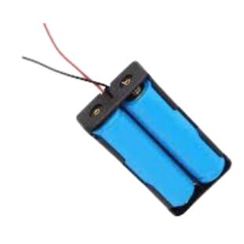
Hardware Components Used
No | Component | Specification | Qty
1 | Arduino UNO R3 | ATmega328P 16 MHz 32KB Flash | 1
2 | L293D Motor Shield Driver | 4 Motors PWM 0 to 255 AFMotor Library | 1
3 | HC-SR04 Ultrasonic Sensor | Range 2 to 400 cm plus or minus 3mm accuracy | 1
4 | SG90 Servo Motor | 0 to 180 degrees 1.8 kg cm torge | 1
5 | HC-05 Bluetooth Module | V2.0 approx. 10m range 2.4 GHz UART | 1
6 | DC Gear Motor | 3 to 6V approx. 150 RPM 200mA | 4
7 | Robot Wheels | Compatible with gear motor shaft | 4
8 | Li-ion Battery 18650 | 3.7V 2600mAh each | 2
9 | Foam Board and Cardboard | Chassis structural material | -
10 | Jumper Wires | Male to Male & Male to Female | set
Power Consumption Summary
Components | Current Draw
Arduino UNO | 50 mA
4 Motors Loaded | 800 mA
HC-SR04 | 15 mA
SG90 Servo | 250 mA
HC-05 | 40 mA
 | ~ 1155 mA
Estimated Cost:
Rs. 800 to 1,200/-
Arduino UNO
L293D Shield
HC-SR04
SG90 Servo
HC-05
DC Motor
Battery
10

Slide 12
Advantages & Disadvantages
Advantages
Disadvantages
✓ | Multi-Modal: 3 operating modes in 1 single platform.
✓ | Low Cost: Complete build only Rs. 800 to Rs. 1200.
✓ | Safety Logic: Voice mode blocks unsafe turning directions.
✓ | Modular Code: Single line comment switches between modes.
✓ | No Router: Direct Bluetooth pairing, no Wi-Fi needed.
✓ | Low Power- HC-05 Bluetooth draws only approximately 40 mA.
✓ | Beginner Friendly: Open-source Arduino platform.
✓ | Expandable: Camera and GPS modules easily addable.
✓ | Educational: Covers UART, PWM, ultrasonic sensing in one project.
× | Limited Bluetooth Range: Effective only up to approximately 10 metres.
× | Single Mode Only: Cannot run two modes simultaneously.
× | No Camera: No live video feed during operation
× | Fragile Chassis: Foam board not waterproof or impac resistant
× | Sensor Limitation: HC-SR04 struggles with soft or angled surfaces
× | No Battery Indicator: Sudden shutdown without warning possible
× | iOS Incompatible: HC-05 not supported on Apple devices
× | No Real-Time Feedback: App does not display live distance or status
11

Slide 13
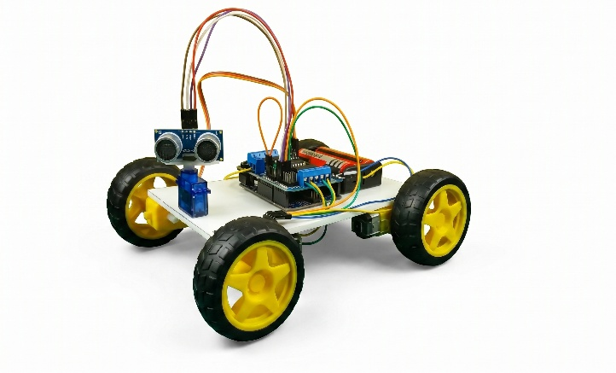
Test Results & Observation
Distance Accuracy Test
Voice Command | Accuracy
FORWARD | 90%
BACKWARD | 80%
LEFT | 90%
STOP | 100%
Overall | 88%
Actual cm | Measured cm | Error | Status
5 cm | 5 cm | 0 cm | STOP
10 cm | 10 to 11 cm | ± 1 cm | STOP
12 cm | 12 to 13 cm | ± 1cm | Threshold
15 cm | 15 cm | 0 cm | FORWARD
30 cm | 29 to 31 cm | ± 1 cm | FORWARD
5 out of 5
Objectives Achieved ✓
Bluetooth Response Test
✓ All 5 commands FBLRS response time less than 50 milliseconds.
✓ Stable connection up to approximately 8 to 9 metres.
Safety Check Test
✓ Obstacle at 6cm – Left Command – Robot STOPPED.
✓ Clear path at 25 cm – Right command – Robot TURNED.
12

Slide 14
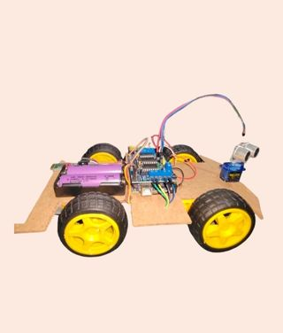
Conclusion
This project successfully designed and built a Multi-Function Robot Car using Arduino UNO-a cost-effective platform integrating 3 control modes into a single embedded system.
Objective | Status | Key Result
Chassis Construction | ✓ Done | Stable 4 wheel foam board chassis
Obstacle Avoidance | ✓ Done | 12 cm threshold ±1 cm accuracy
Bluetooth Control | ✓ Done | All 5 commands less than 50ms response
Voice and Safety | ✓ Done | 88% accuracy & 100% safe turn check
Modular Code | ✓ Done | 1 – line mode switching
Key Learnings
UART serial communication HC-05 and Arduino
PWM motor control via L293D shield
Ultrasonic distance via pulseln function
Servo scanning for environment awareness
Safety-aware human-robot voice interaction
Intelligent, multi-modal robots can be built at a fraction of commercial cost using open-source Arduino platform.
13

Slide 15
Future Scope & Enhancements
No | Enhancement | Technology | Benefit
1 | Wi-Fi and loT Control | ESP32 module | Control from anywhere via internet
2 | Live Camera Feed | ESP32-CAM | Real-time video to smartphone
3 | Custom Flutter App | Flutter Android and iOS | Joystick plus radar animation plus voice
4 | 360 Degree Scan | Stepper motor | Full-circle environment mapping
5 | Battery Indicator | Voltage divider circuit | Prevents sudden shutdown
6 | Speed Encoder | Hall effect sensor | Actual RPM closed-loop feedback
7 | Al Object Detection | OpenCV with Raspberry Pi | Recognize specific objects autonomously
8 | GPS Tracking | NEO-6M GPS module | Track robot location on map
9 | Stronger Chassis | 3D printed or acrylic | Waterproof and rigid structure
Immediate Next Steps
Add HC-05 Bluetooth status LED indicator
Speed control slider in Bluetooth app
Build custom RoboNex Flutter mobile app
14

Slide 16
Reference & Bibliography
Textbooks
Datasheets
1-Paul Scherz and Simon Monk , Practical Electronics for Inventors, 4th Edition, McGraw-Hill 2016
2-Michael Margolis, Arduino Cookbook, 2nd Edition O'Reilly Media 2012
3-Warren Adams and Molle - Arduino Robotics, Apress 2011
HC-SR04 Datasheet, ElecFreaks 2013
HC-05 AT Command Set Wavesen Technologies 2011
SG90 Servo Datasheet, TowerPro 2010
Bluetooth Core Specification v2.0 plus EDR Bluetooth SIG with URL bluetooth.com
Online References
1. SriTu Hobby 'How to Make a Multi-Function Arduino Robot‘ srituhobby.com 2. Arduino Official Arduino UNO Technical Specs arduino.cc
3. Adafruit AFMotor Library Documentation leam.adafruit.com
15

Slide 17


THANK YOU
Thank you for your valuable time and attention.
We are grateful to:
Ms. Chinmayee Medhi - Project Supervisor and Guide
Mr. Amit Kumar Das - Head of Department
Principal Jitu Moni Deka - Chirang Polytechnic Bijni Assam
SCAN QR CODE FOR:
Complete Project Overview | Circuit Diagrams & Code | FAQs & Troubleshooting | Video Demo & Working | Future Enhancements
Mail: robotcar.chp23el@proton.me
Dept. of Electrical Engineering | Chirang Polytechnic, Bijni, Assam | 26th May, 2026

